Slide 1
ENSE 374, MILESTONE 4
Group 11
Nick
Yash
Rabaa
[December 2nd 2019 ]

Slide 2
REVIEW THE PROJECT VISION
What is your team’s Golden Circle
  WHAT: A website that helps citizens to know more about the election’s candidates
  WHY: The news channels would prefer to tell you that a candidate doesn’t brush his teeth rather than what does he concentrate to do. We will pick the appropriate references that would help the citizen.
  HOW: Web scrap appropriate references that would save the user his time searching for one.
Deep dive
  Our why question defines the gap.
    Project vision: An informative website that runs before every election.
    Rationale: Due to false or useless news written about the elections candidates, we will provide reliable information from internet sources.
    Stakeholders: Government / Voters
    Assumptions: Our references are honest and trustworthy
    Constraints: Making sure that the people will trust us as being unbiased.

Slide 3
TEAM WORK/RESPONSIBILITIES
Discuss team member responsibilities throughout the project
  Yash: Styling the webpages and make them dynamic ->JS.
  Rabaa: html, web scraping portion and lo-fid designs.
  Nick: Managing the databases and documentation.
  We had our weekly meetings, discussing our *Work done *Plans for next week * problems
  We made sure to divide our work based on our experiences, and to manage our time always to make an early release.

Slide 4
MVP 2 DEMO
Demo your tool
http://www2.cs.uregina.ca/~liu725/374project/trial.php
Describe why you feel it is a good MVP
  MVP 2 is improvement of MVP 1
  MVP1----Basic web page and database
  MVP2----Better views and connection with database

Slide 5
FEELINGS
Feelings
  Do you consider your project a success
    What are some highlights
    We consider our project to be a success as we were able to accomplish the initial goal and idea we set for ourselves and the website.
    What are some “better-ifs”
    We feel that our website would be better-off if there were more quantity of reliable sources available on the internet.
  How many changes/direction shifts did your team take?
  There were quite a fe changes and direction-shifts that we had to undergo as we were working on our project. As an example, after the second milestone, we had to completely change the direction in which we initially decided our project to move forward. As a result, we were in a way, back to square one.
  Do you consider your code clean? Why/why not? Recommendations?
  We feel that our coding has been clean throughout the project. As to why we feel so, Rabaa over here will go through the coding of our website.

Slide 6
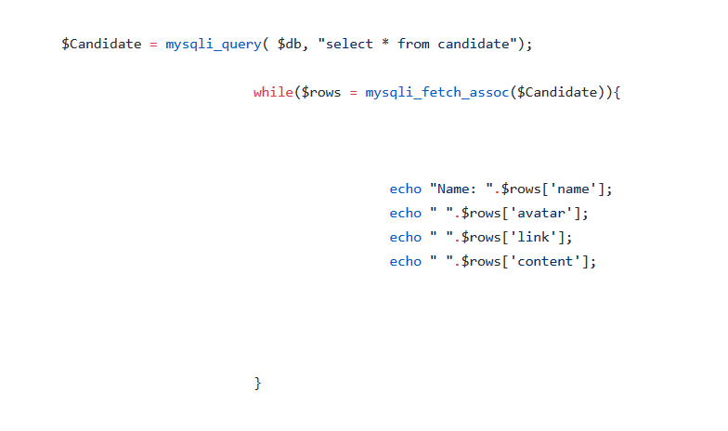
CLEAN CODE

Slide 7
FUTURE MVPS & GITHUB
Discuss what your team envisioned for potential next MVPs
  Adding comment function
  Making election page more organized
Review your team’s GitHub
https://github.com/Nick-liu666/374group-project

Slide 8
GROUP REFLECTION
How did you feel about this project? What did you like about it? What did you dislike?
  [We are proud to finally haveour website completed. It was quite fun working on this project, although the lack of reliable sources on the internet was something we didn’t like very much.]
What did you learn about yourself as you collaborated and worked through this project?
  [Collaborating on this project has given us a better idea about clean coding. It has also shed some light on what its like to work on such team projects.]
How will you use what you have learned going forward?
  [We feel that this knowledge of team-work willbecome quite handy when we are out in the field working on team-based projects.]
What “stuff & things” related to this project would you want help with? – Could have been better?
  [As of now, we feel that we don’t require any help regarding anything in our project.]

